Slide 1
Possible Directions from Sep 20
verify with other locations of Tx and Rx
fix client, adversary moving in semi-circular path
verify with different set of initialization to know if the memory-based initialization has a benefit

Slide 2
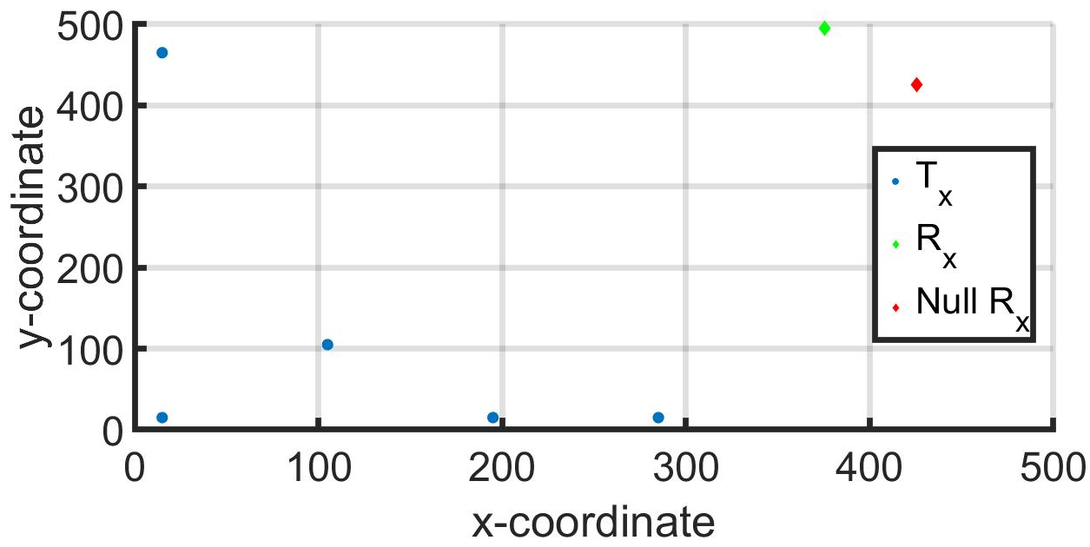
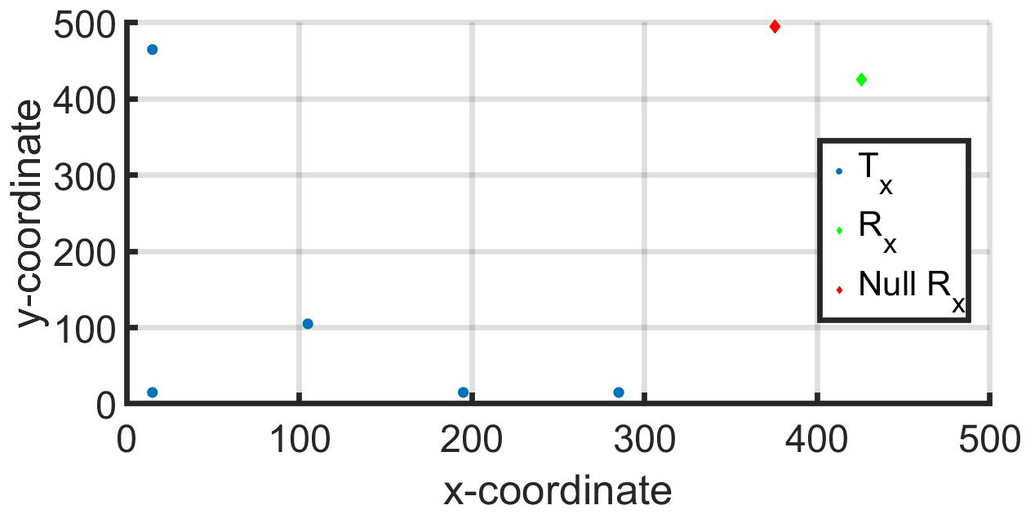
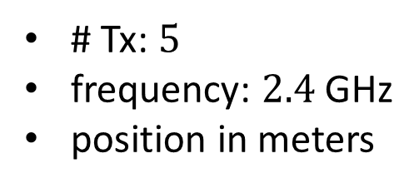
(x,y)-Position of Agents and Receivers
(a)
(b)
# Tx: $5$
frequency: $2.4$ GHz
position in meters

Slide 3
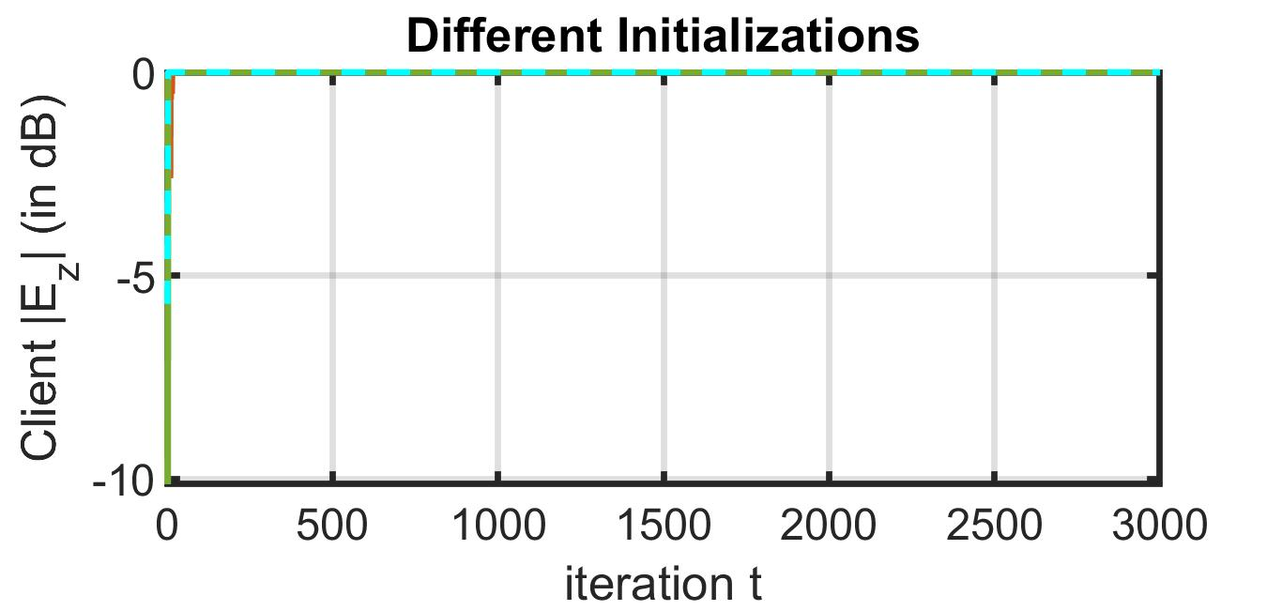
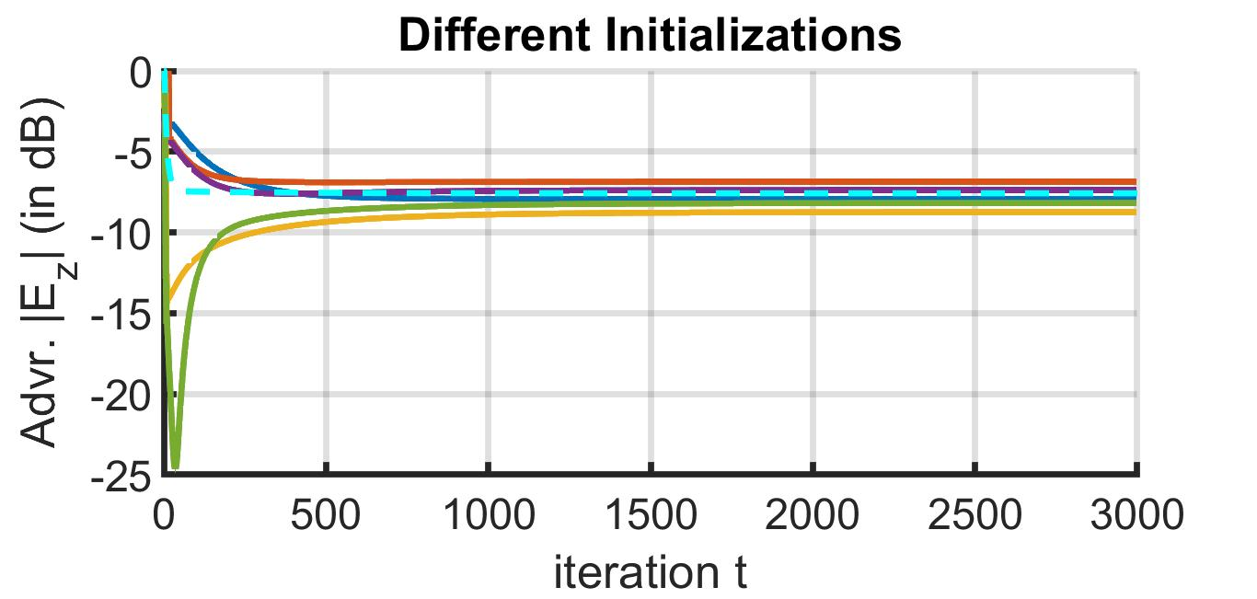
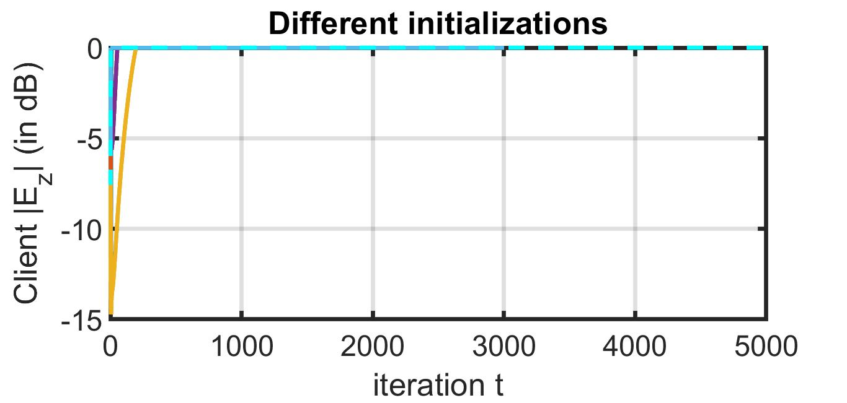
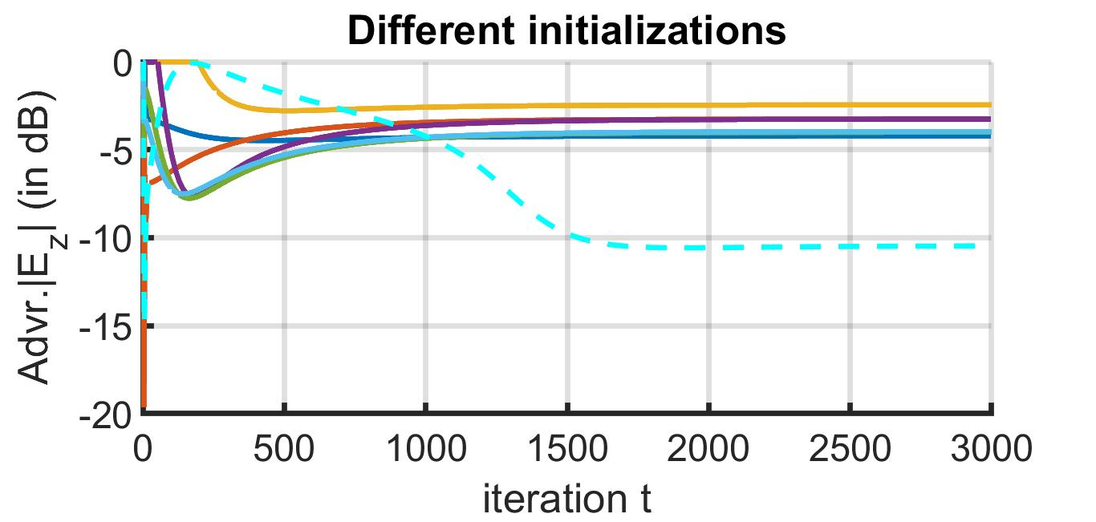
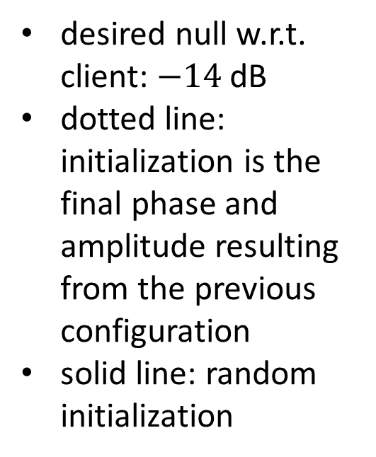
Amplitude of Electric Field in z-Direction
(a)
desired null w.r.t. client: $−14$ dB
dotted line: initialization is the final phase and amplitude resulting from the previous configuration
solid line: random initialization
(b)

